Slide 1
Life Edit Final Deliverable

Slide 2

Project Overview
Life Edit is a gene editing company that aims to develop gene therapies for complex genetic disorders.
They hope to treat individuals with genetic disorders which were previously untreatable
Project goal: develop a classifier that differentiates edited cells and unedited cells using RNA gene expression data
Determining differences between edited and unedited cells is essential for Life Edit to understand the impact of its editing tools

Slide 3
Work Summary
Refined the methods used to select features for classification
Creating a filtered set of genes based on differences in gene expression
Performed PCA and selected the most important genes from each principal component
Created new clusters of genes based on biological function
Trained and tested machine learning classifiers using these different sets of features to determine which features best differentiated between edited and unedited cells

Slide 4
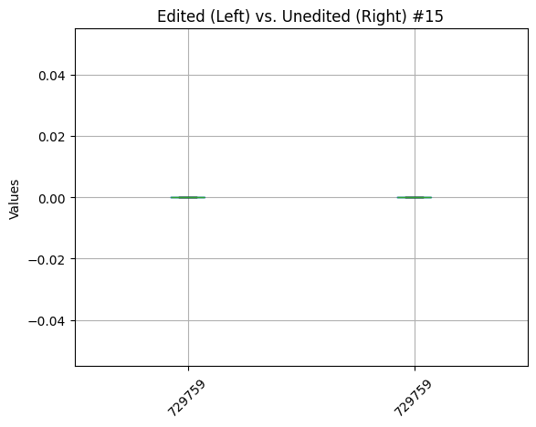
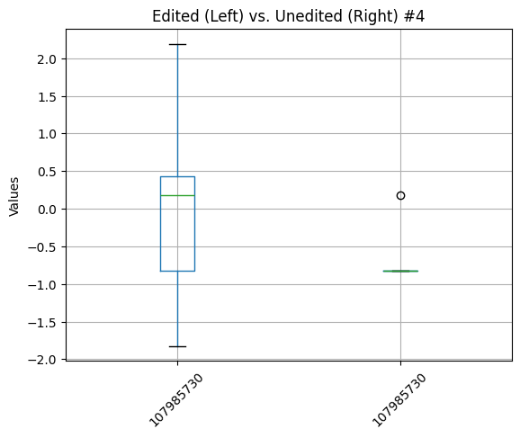
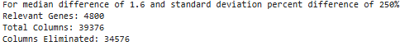
Gene Filtering
Over 39000 genes -> less than 5000
Notes:
Soham

Slide 5
Model Experimentation
Random Forest
Light Gradient Boost (LGB)
K Nearest Neighbors (KNN)
`
Notes:
Soham

Slide 6
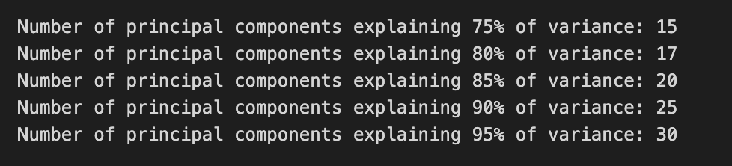
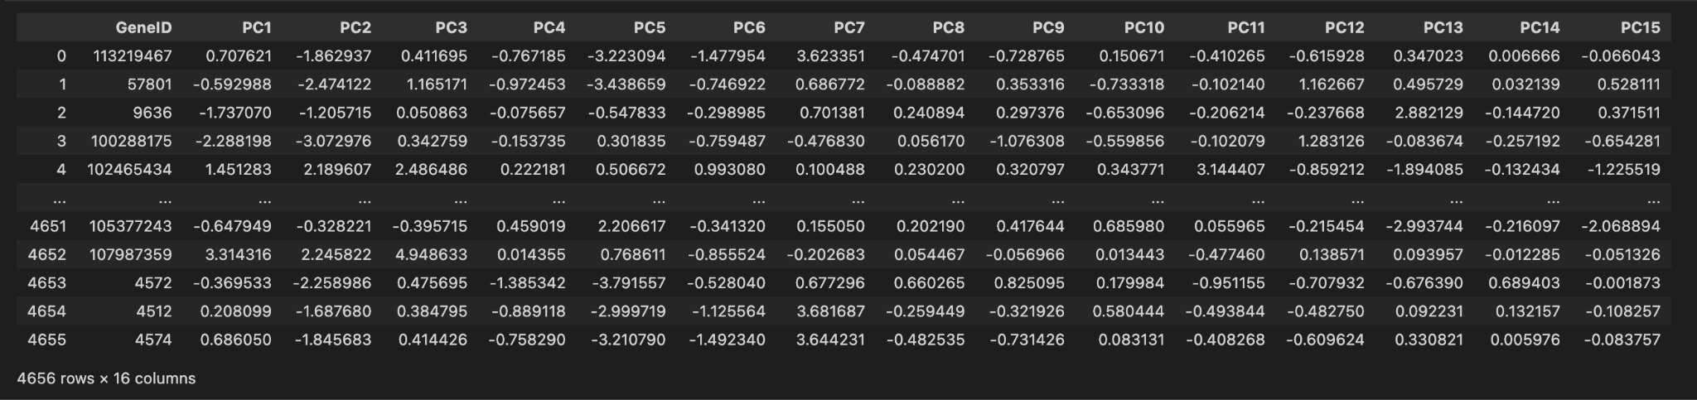
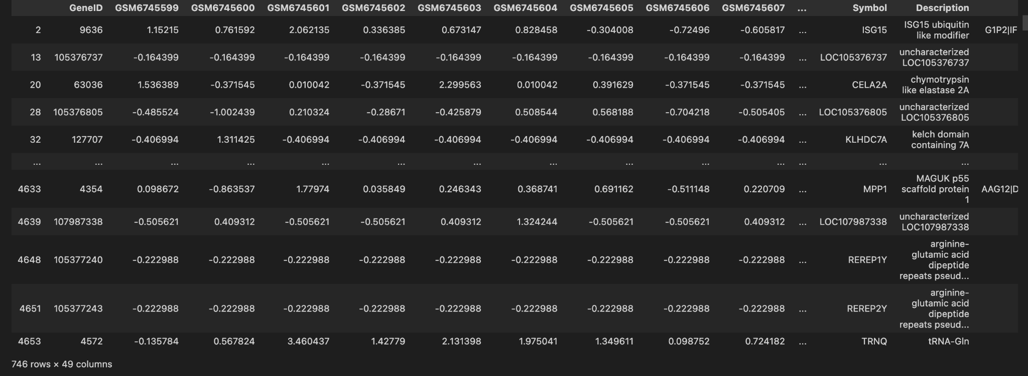
PCA on Genes
# of PC’s needed to explain 75% of variance
PCA with 15 PC’s
Ran PCA on 4,656 genes based on filtered dataset
Reduced from 4,656 genes to 746 genes (top 30 genes for each PC)
Got top k genes for each PC, then filtered genes dataset
*Make edit to get top genes that explain x% variance

Slide 7
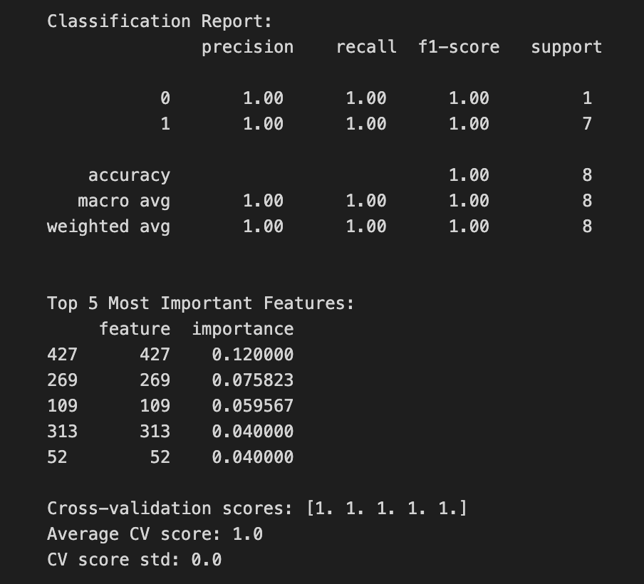
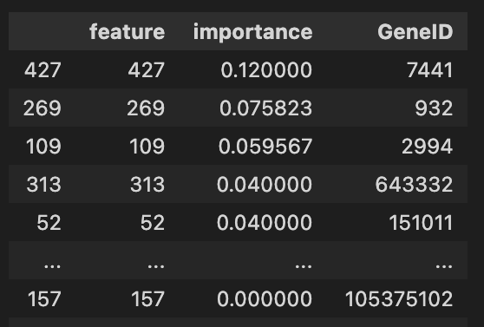
Random Forest Classifier
1. Training
2. Grid search:
5 cross-validation subsets
Runs in parallel for computation speed
Uses F1-macro scores (handling both classes equally)
Predicting edited/unedited labels using filtered dataset (top k genes)
3. Best parameters:
class weight: balanced
max depth: None
minimum samples for leaf: 2
minimum samples for split: 5
number of trees: 50
Highest cross-validation score: 0.89
2. Parameter Tuning
1. Parameters to tune:
Number of trees in the forest.
[50, 100, 200]
Maximum depth of the trees
[None, 5, 10]
Min data points needed to split or form a leaf (depth vs. generalizability trade-off)
[2, 5]
[1, 2]
Class weight: for class imbalances
Balanced, balanced subsample
4. Important Features
3. Model Testing
Notes:
A Random Forest Classifier is an ensemble machine learning algorithm used primarily for classification tasks, although it can also be applied to regression. It builds upon the concept of decision trees by combining multiple trees to improve overall accuracy and robustness, reducing the risk of overfitting. Identify patterns in gene expression levels to distinguish between edited and unedited samples.
Key Concepts:
Decision Trees: Each tree in the forest is a decision tree, which makes predictions by splitting data into branches based on features until it reaches a decision (leaf node).
Ensemble Learning: Random Forest is an ensemble method, meaning it combines the output of multiple models (trees) to produce a single result. It leverages the "wisdom of crowds" concept.

Slide 8
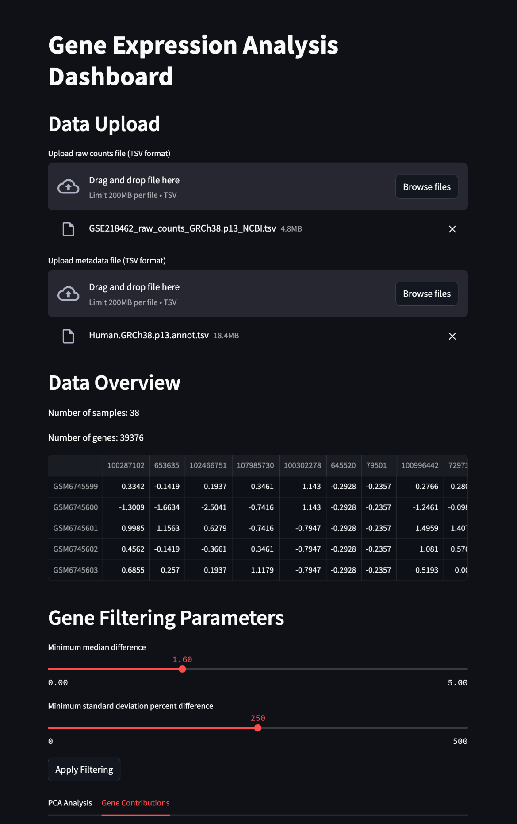
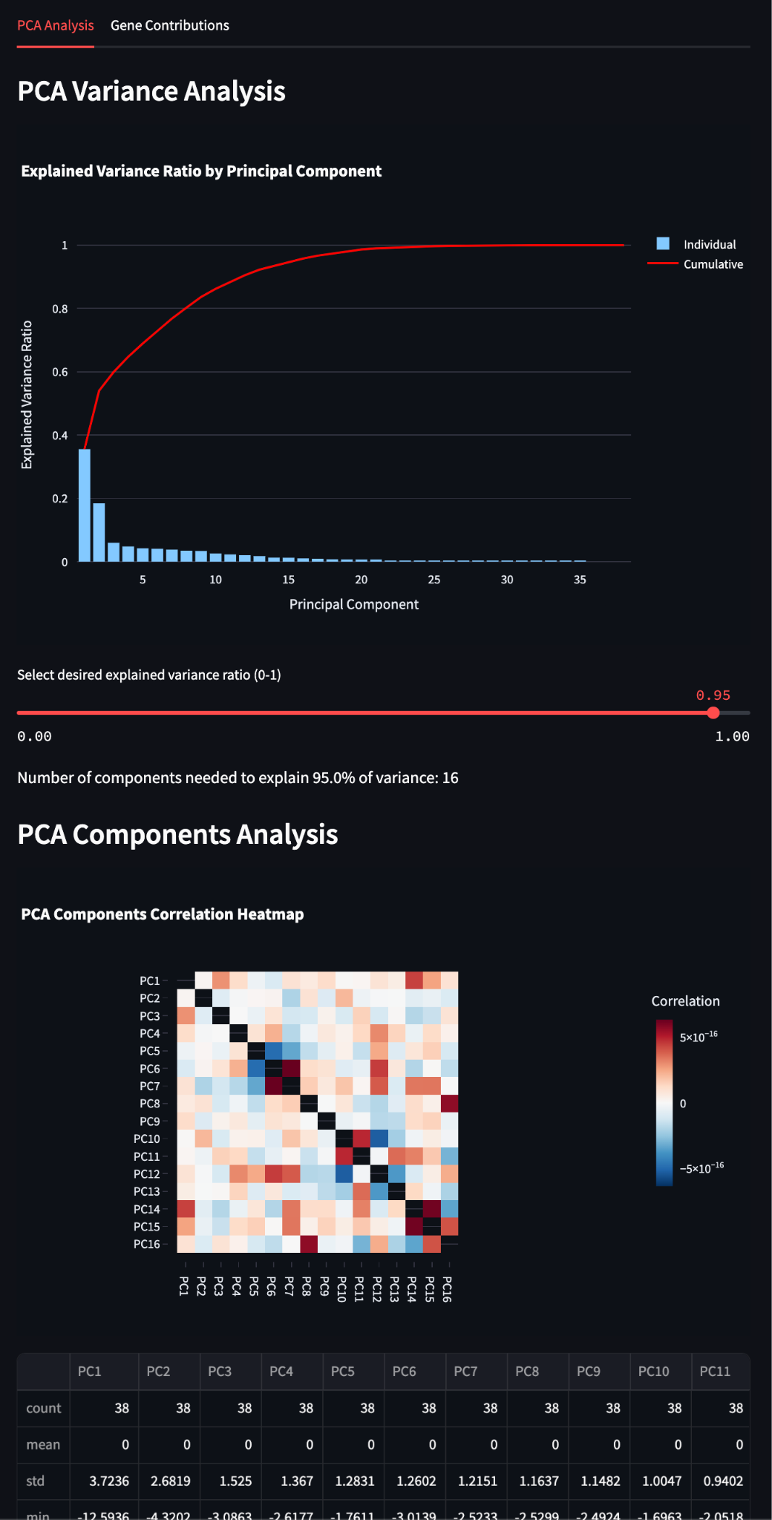
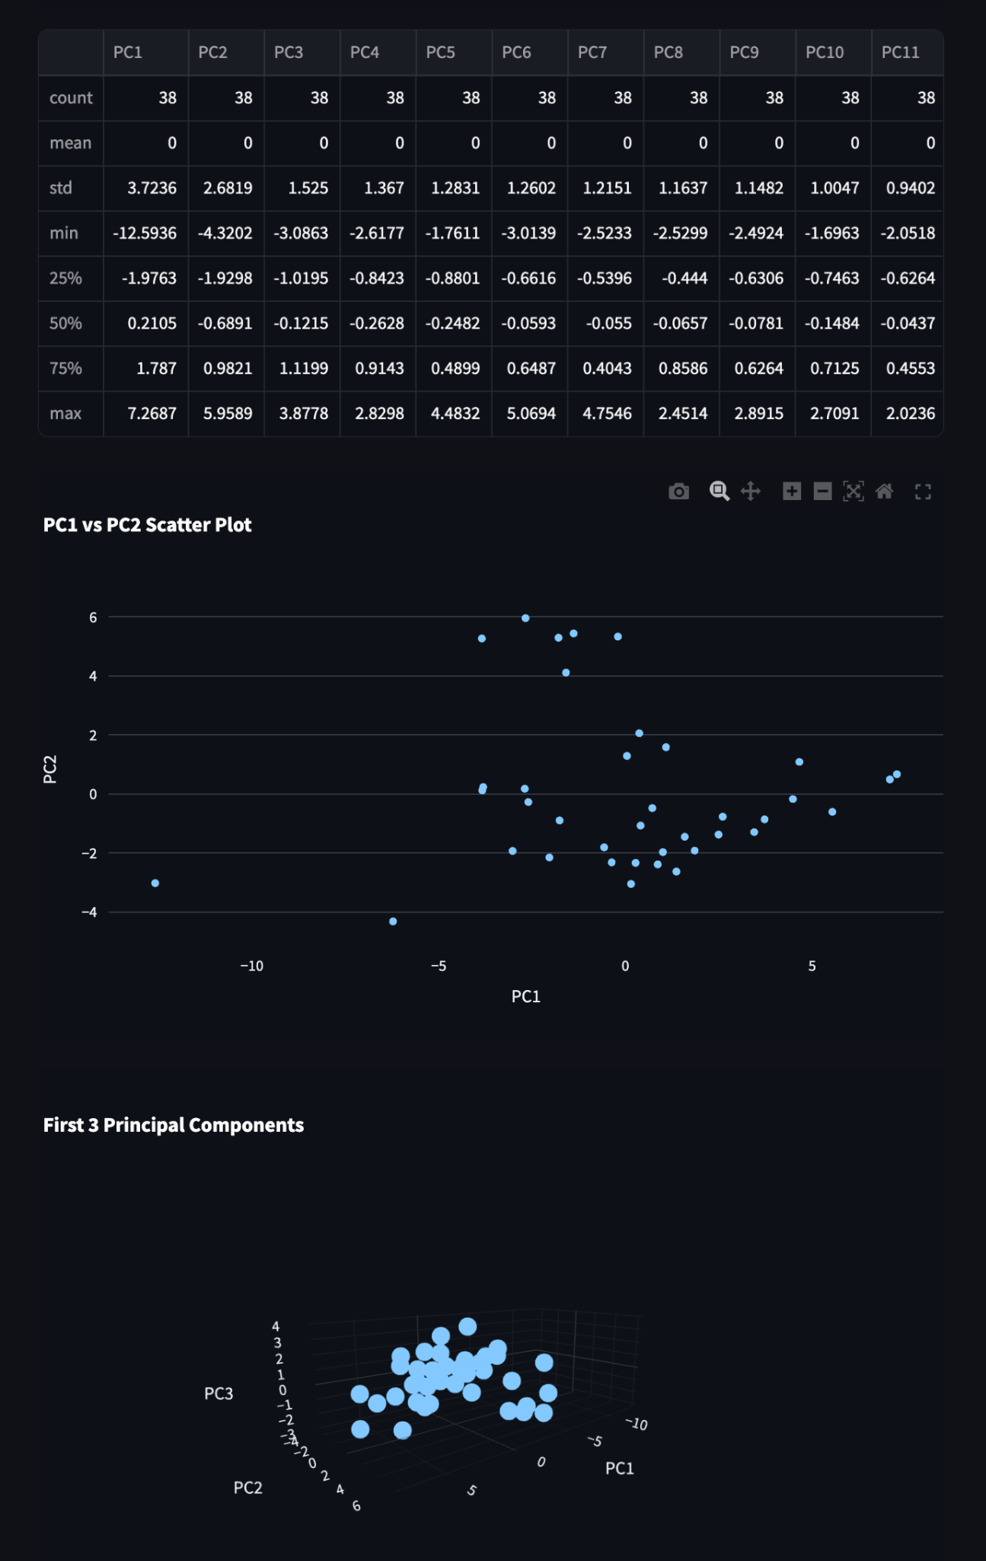
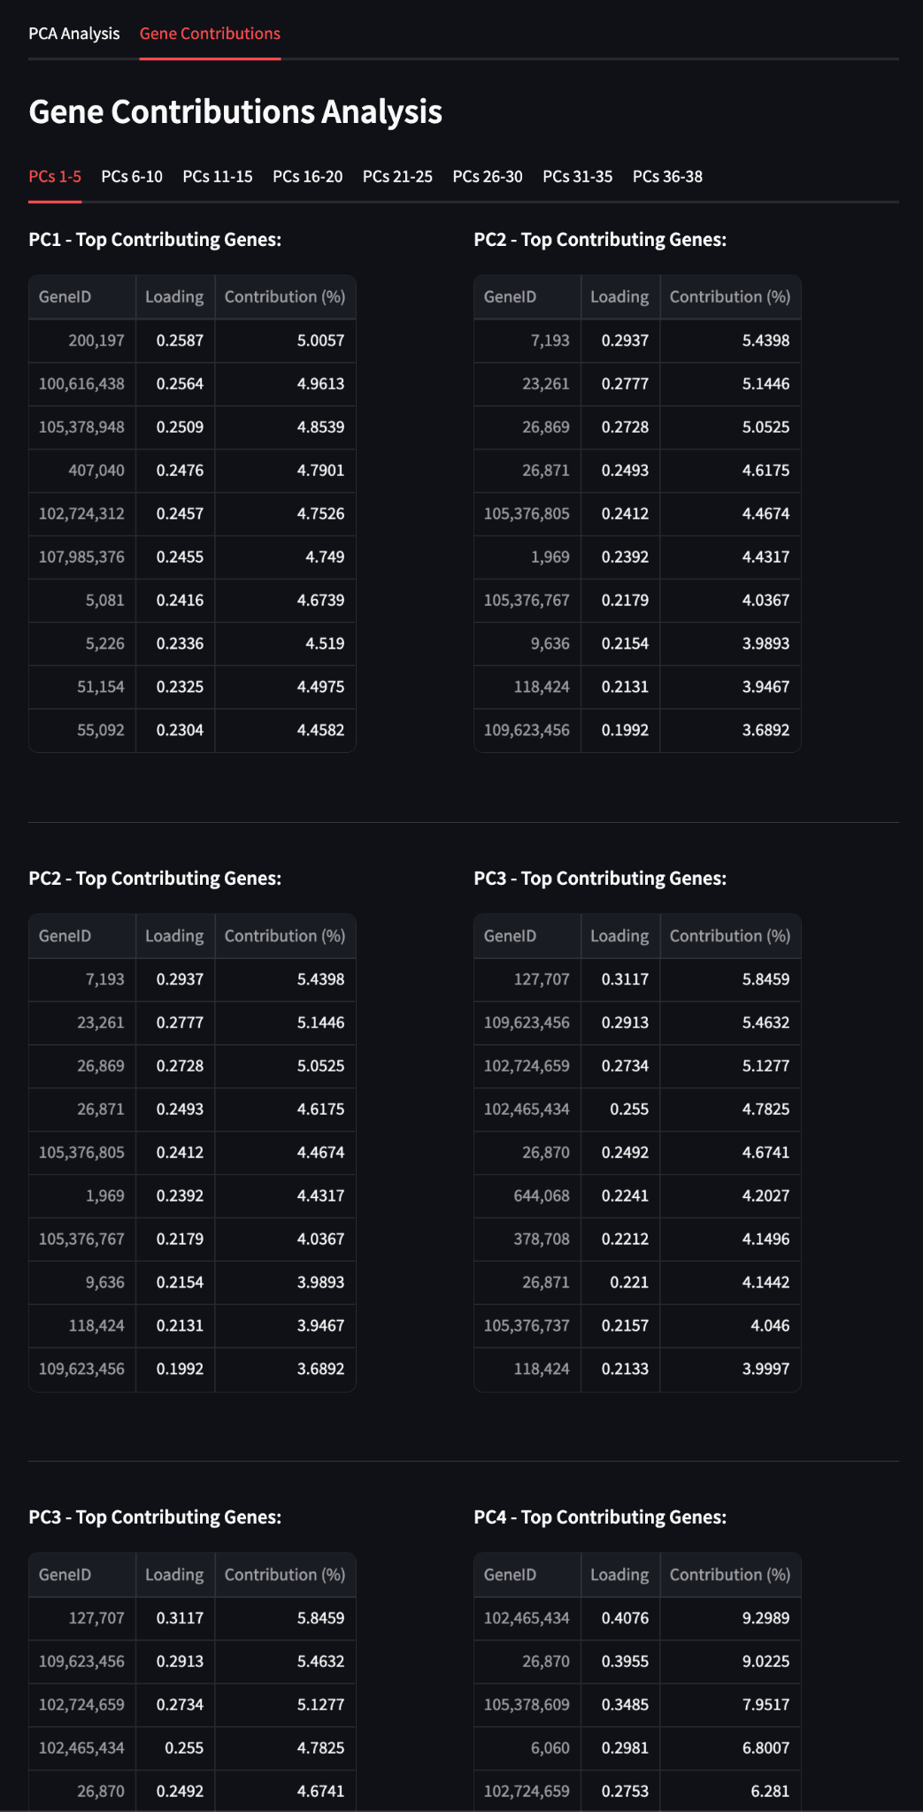
Dashboard Curation

Slide 9
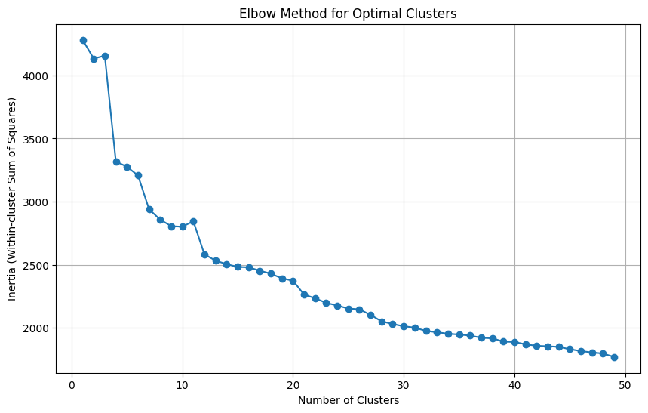
K-Means & Elbow Clustering Results
Elbow Clustering (9 Clusters)
Cluster Naming & Cluster Science
Divergent Pseudogene-Enriched Immunoglobulin and Transcriptomic Regulatory Cluster
Integrative Gene Cluster for Signaling, Transport, and Stress Response
Non-readable Genes (NAN Entries)
Integrative Regulators of Transcriptional, Translational, and Signal Modulation Pathways (IR-TTSMP)
Uncharacterized Genetic Elements with Potential Roles in Genomic Regulation and Evolutionary Adaptation (UGE-GREA)
Dynamic Structural Interaction and Regulatory Domain Cluster (DSIRDC)
Chromosomal Open Reading Frame (CORF) Cluster
Long Intergenic Non-Coding and Antisense RNA Regulatory Gene Network Cluster
Multifunctional Regulatory RNA and Extracellular Dynamics Hub (MRRED-Hub)
Notes:
Clusters Created Using K-Means

Slide 10
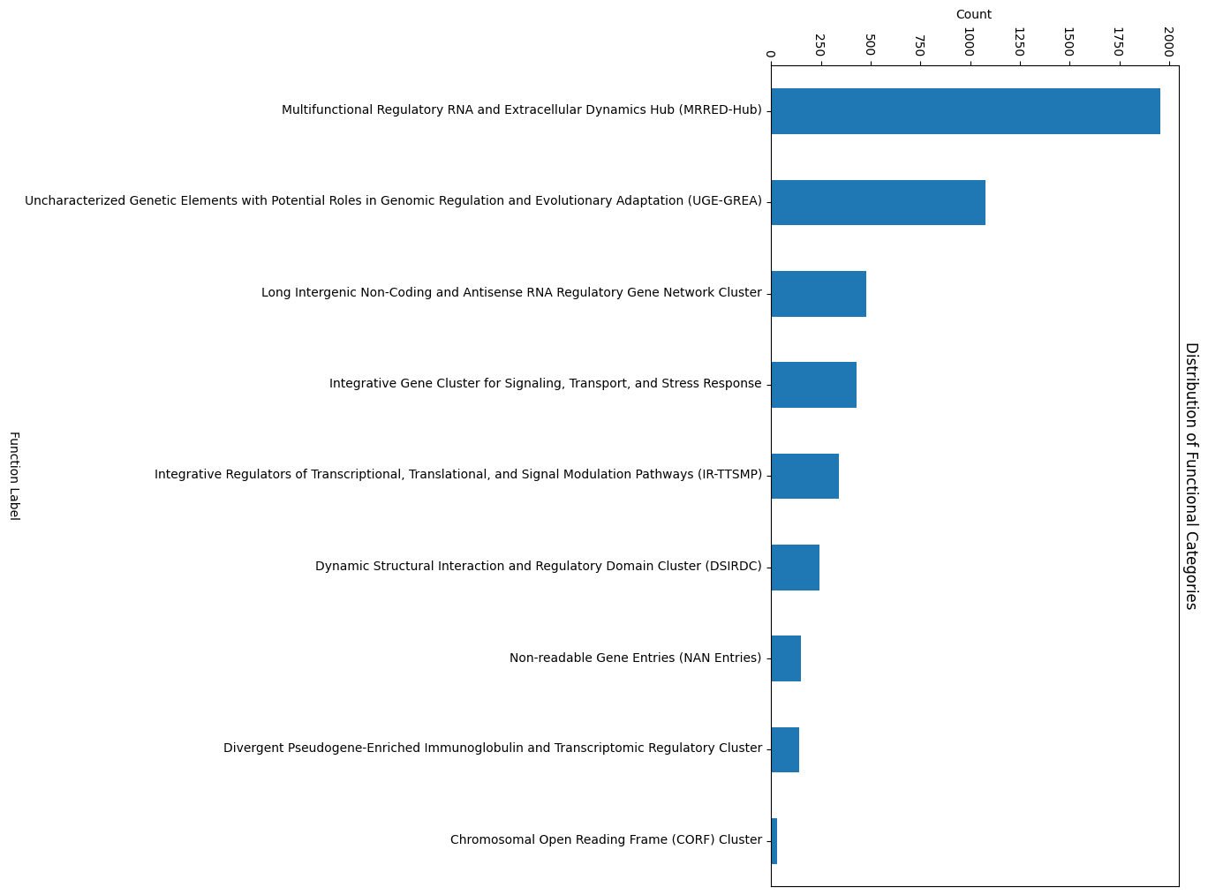
Random Forest Classifier Results on New Clusters
Notes:
High-level summary of the categorization process, libraries, and methodologies used:
Data Preparation and Feature Extraction: We used BERT (Bidirectional Encoder Representations from Transformers) embeddings to convert gene/protein descriptions into feature-rich vector representations. BERT, from the Hugging Face Transformers library, captures semantic nuances, allowing similar terms to have similar embeddings, crucial for clustering related descriptions.
Clustering Algorithm: We applied a clustering algorithm (typically K-Means or a similar model from the scikit-learn library) on these BERT embeddings. This process grouped genes/proteins based on semantic similarity, creating clusters that reflect related functions or biological roles.
Cluster Labeling: Post-clustering, clusters were manually analyzed to identify common functional themes. Each cluster was then assigned a descriptive label based on the shared characteristics of the genes/proteins within it. This labeling provided meaningful insights into the general role of each group.
Result Annotation and Refinement: The final output, stored in a new DataFrame column, allows easy reference to cluster labels. This process used pandas for data manipulation and scikit-learn for clustering, while the BERT embeddings facilitated context-aware categorization of gene/protein functions.

Slide 11
Conclusions
The Random Forest Classifier was the best performing model when using the filtered set of 5000 genes
Only a very small percentage of genes from each principal component was needed for strong model performance
Using the clusters based on biological function as features showed promising results with Random Forest
Further work is needed to determine which of these two feature selection methods is best: selecting genes based on PCA or creating clusters based on biological function

